Slide 1
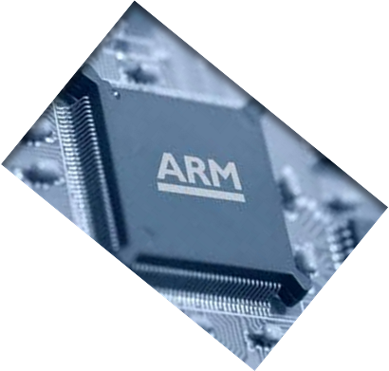

MICROPROCESSOR AND COMPUTER ARCHITECTURE
INTRODUCTION TO PIPELINING
Credits:
MPCA Team
Notes:
<number>

Slide 2
performance Improvement of computing systems in today’s context
Pipelining
Notes:
<number>

Slide 3

Pipelining – An Introduction
Pipelining - Multiple instructions are overlapped in execution.
- Advantage of parallelism that exists among the actions needed to execute an instruction.
- In current day processors, pipelining is the KEY implementation feature to make fast processors.
Ex: Assembly line in the construction of an automobile.
.
-

Slide 4
Pipelining – An Introduction
Each step operates in parallel with other steps, although on a different automobile [instructions].
In a computer pipeline, each step in the pipeline completes part of the instruction.
Different steps complete different parts of different instructions in parallel.
Each of these steps is called pipe stage / segment.
All these stages are connected one to next to form a pipe.
Instructions enter from one end, Progress through the stages & exit through the other end.

Slide 5
5 Stage Pipelining- Throughput:
In automobile industry, no. of cars / automobiles assembled per hour. i.e., How often a completed car exits the assembly line.
In a computer, throughput is determined by How often an instruction exits the pipe line.
All pipe stages are related together, all stages must be ready to proceed at the same time.
The time required to move an instruction from stage i to stage i+1 in the pipeline is a processor cycle.
All stages proceed at the same time.

Slide 6
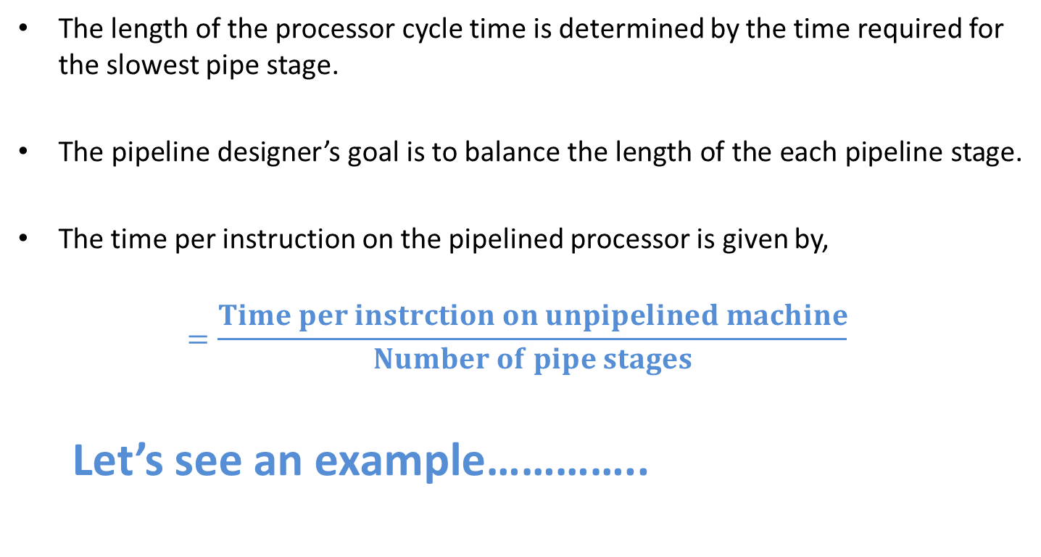
5 Stage Pipelining- Throughput:

Slide 7
Pipelining: Its Natural!
Laundry Example
Amar, Babu, Cathy, Dave
each have one load of clothes
to wash, dry, and fold
Washer takes 30 minutes
Dryer takes 40 minutes
“Folder” takes 20 minutes
A
B
C
D

Slide 8
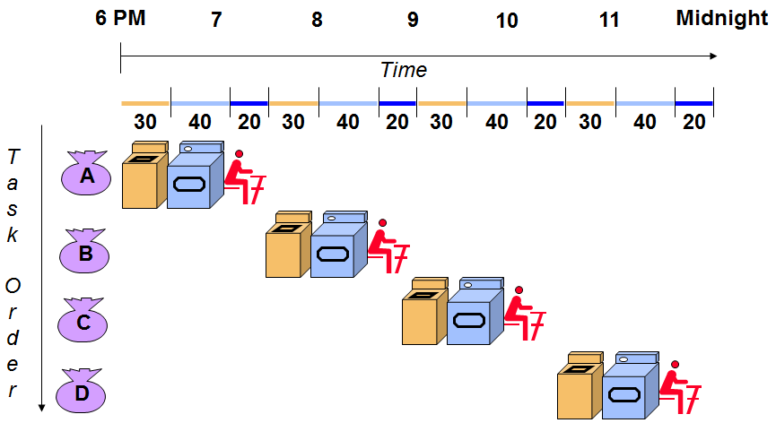
Sequential Laundry
Sequential laundry takes 6 hours for 4 loads

Slide 9
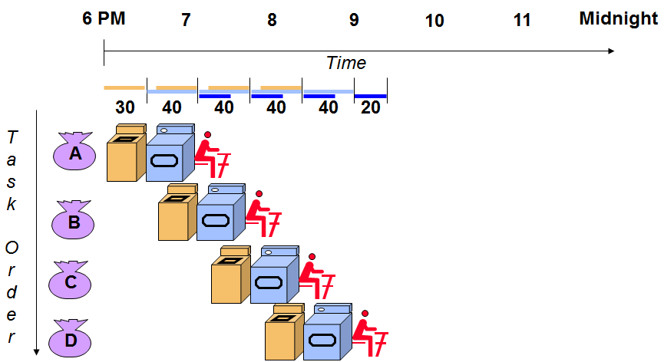
Pipelined Laundry Start work ASAP
Pipelined laundry takes 3.5 hours for 4 loads

Slide 10
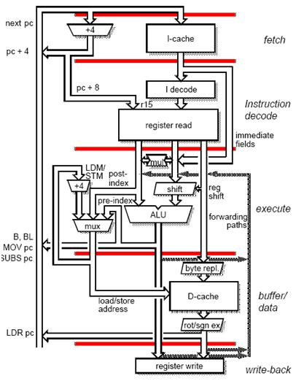
ARM Architecture - 5 Stage Pipeline - example
Fetch - [IF]
Decode – [ID]
Execute – [EX]
Buffer / data or Memory Access-[MEM]
Write back – [WB]

Slide 11
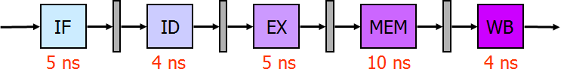
Pipeline Throughput and Latency
Consider the pipeline above with the indicated delays. We want to know what is the pipeline throughput and the pipeline latency.
Pipeline throughput: instructions completed per second.
Pipeline latency: how long does it take to execute a single instruction in the pipeline.

Slide 12
Pipeline Throughput and Latency
Pipeline throughput: how often an instruction is completed.
Pipeline latency: how long does it take to execute an instruction
in the pipeline.
Is this right?

Slide 13
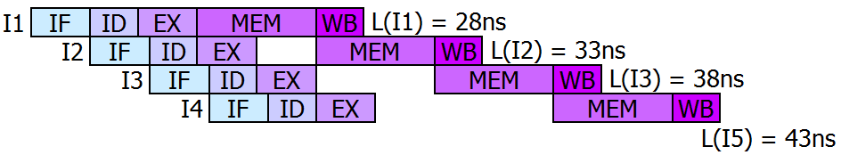
Pipeline Throughput and Latency
Simply adding the latencies to compute the pipeline latency, only would work for an isolated instruction
We are in trouble! The latency is not constant. This happens because this is an unbalanced pipeline. The solution is to make every state the same length as the longest one.

Slide 14
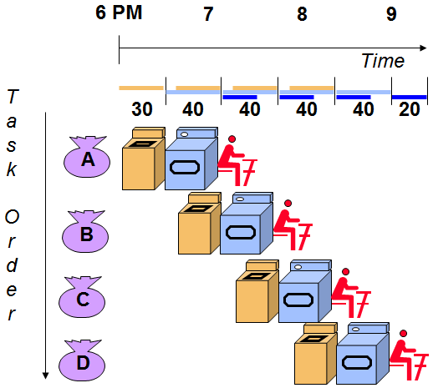
Pipelining Lessons
Pipelining doesn’t help latency of single task, it helps throughput of entire workload
Pipeline rate limited by slowest pipeline stage
Multiple tasks operating simultaneously
Potential speedup = Number pipe stages
Unbalanced lengths of pipe stages reduces speedup
Time to “fill” pipeline and time to “drain” it reduces speedup

Slide 15
ARM 7TDMI vs 9TDMI
ARM 7DMI
Von Neumann Architecture
3 stage pipelining
CPI ~ 1.9
ARM 9TDMI
Harvard Architecture
Increases the available memory bandwidth
Allows simultaneous access to instruction and data memory
5 stage pipelining
CPI ~ 1.5

Slide 16
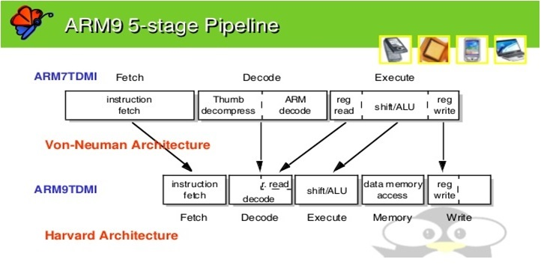
3-stage & 5-stage comparison :
How to arrive at 5 stage pipeline from 3 stage pipeline?
Notes:
<number>

Slide 17
ARM Architecture - 5 Stage Pipelining
Fetch - [IF]
The instruction is fetched from memory and placed in the instruction pipeline.
Update the PC to the next sequential PC by adding 4 to PC.
Decode – [ID]
The instruction is decoded and register operands read from the register files. There are 3 operand read ports in the register file so most ARM instructions can source all their operands in one cycle.
Do the equality test on the registers as they are read, for a possible branch.
Sign extend the offset field of the instruction in case it is needed.

Slide 18
ARM Architecture - 5 Stage Pipelining- Decode stage - [ID]
Compute the possible branch target address by adding the sign-extended offset to the incremented PC.
Further, the branch can be completed by the end this stage by storing the branch target address into the PC if condition yielded true.
Decoding is done in parallel with reading registers, as the register specifiers are at fixed location in a RISC architecture.
Known as fixed –field decoding.
Registers may be read which may not be used, that doesn’t hurt the performance.

Slide 19
ARM Architecture - 5 Stage Pipelining Execute – [EX]
Also called as execute / effective address cycle.
The ALU operates on the operands prepared in the previous cycle, performing of the three functions depending on the instruction type.
Memory Reference: the ALU adds the base register and the offset to form the effective address.
Register – Register ALU instruction: The ALU performs the operation specified by the opcode on the values read from the register file.
Register – Immediate ALU instruction: The ALU performs the operations specified by the opcode on the first value read from the register file and the sign extended immediate.
NOTE: In LOAD / STORE architecture, the EA and execution cycles can be combined into a single clock cycle, as no instruction needs to simultaneously calculate a data address and perform an operation on the data.

Slide 20
ARM Architecture - 5 Stage Pipelining - Memory Access [MEM]
Buffer/Data or Memory Access-[MEM]
Data memory is accessed if required. Otherwise the ALU result is simply buffered for one cycle.
If the instruction is a LOAD, the memory does a read using effective address computed in the previous cycle.
If the instruction is a STORE, then the memory writes the data from the second register read using the effective address.

Slide 21
ARM Architecture - 5 Stage Pipelining
Write back – [WB]
Write back – [WB]
The result generated by the instruction is written back to the register file , including any data loaded from memory.
The data may come either from memory system [for LOAD], or from the ALU [ for an ALU instruction].

Slide 22
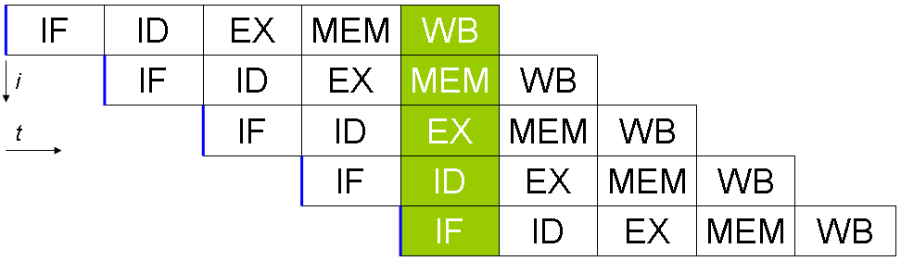
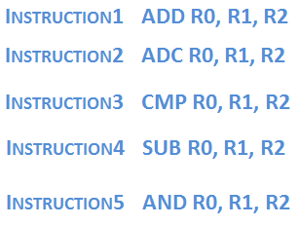
ARM - 5 Stage Pipelining
i - Instructions
t - Cycle Time
NOTE: In 5 stage pipeline implementation:
BRANCH requires 2 cycles, STORE require 4 cycles and all other instructions requires 5 cycles.

Slide 23
ARM - 5 Stage Pipelining - Execution
Start a new instruction on each clock cycle.
A cycle in PIPELINE : Each of the clock cycles from the previous section becomes a PIPE stage
Each instruction takes 5 clock cycles to complete, during each clock cycle the hardware will initiate a new instruction.
The hardware will be executing some part of the five stage different instructions.

Slide 24
ARM - 5 Stage Pipelining - Execution
Previous Example:
Instruction1 in cycle 5 would be in WB stage .
Instruction2 in cycle 5 would be in MEM stage.
Instruction3 in cycle 5 would be in EX stage.
Instruction4 in cycle 5 would be in DE stage.
Instruction5 in cycle 5 would be in IF stage.
NOTE: It is hard to believe that pipeline is as simple as described.
But the fact of the matter is : IT’s NOT.
Reality is to deal with problems that the PIPELINE introduces. In future slides….

Slide 25
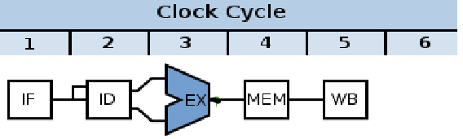
Problems that the PIPELINE introduces
Determine what happens during every clock cycle of the processor.
Not to perform 2 different operations with same data path resource the same cycle time
Ex: ALU cannot be asked to compute the Effective Address and perform subtract operation at the same time.
Ensure that overlap of instructions in the pipeline cannot cause such a conflict.
Fortunately, RISC instruction set makes resource evaluation relatively easy.

Slide 26
Problems that the PIPELINE introduces
Major functional units are used in different cycles. Hence, overlapping the execution of multiple instructions introduces relatively few conflicts.
Separate data and instruction memory – HARVARD architecture.
Register file / Register bank is used in two stages – One for reading in ID & writing in WB.
PC updating during every clock cycle i.e., Increment and store in PC .

Slide 27
Problems that the PIPELINE introduces
Major functional units are used in different cycles. Hence, overlapping the execution of multiple instructions introduces relatively few conflicts.
Separate data and instruction memory– HARVARD architecture.
Register file / Register bank is used in two stages – One for reading in ID & writing in WB.
PC updating during every clock cycle i.e., Increment and store in PC .
Requires adder to compute the potential branch target during the ID stage.
Branch does not change PC until the ID stage.
Thus creates problem. This will be handled shortly in hazards.
Structural , Data & Control Hazards.
Ensure that the instructions in the pipeline do not interfere with one another.

Slide 28
Q & A
Introduction to 5 stage pipeline
Notes:
11/02/16
<number>

